Slide 1
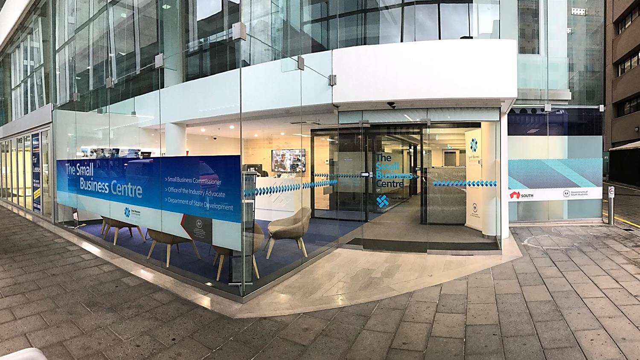


Adjudicate Today
Annual Adjudicator Seminar – 22nd March 2019

Slide 2
Building & Construction Industry Security of Payment Act 2009
The SA Building and Construction Industry Security of Payment Act 2009 (the Act) commenced on 10 December 2011
In South Australia, the Act is committed to the Minister for Industry and Skills
It is administered by the Small Business Commissioner
Notes:
When it was enacted in 2009, the Building and Construction Industry Security of Payments Act 2009 (the Act) was intended to ensure that a person who carries out construction work or who supplies related goods and services, under a building or construction contract is entitled to receive and able to recover progress payments for carrying out that work, or supplying those goods and services.
Under the regime of the Act, a claimant is deemed to be entitled to payment on a claim pursuant to the Act, unless the respondent provides a “payment schedule” setting out how, or why, payments will be made, or withheld.
If the claimant is dissatisfied with the payment schedule offered by the respondent, the claimant can take the matter to ‘adjudication’ via an Authorised Nomination Authority that will appoint an Adjudicator.
Alternatively, if the respondent simply fails to provide a payment schedule, or provides a payment schedule but fails to pay in accordance with it, then any unpaid part of the claim automatically becomes a debt that is able to be enforced through a Court.

Slide 3
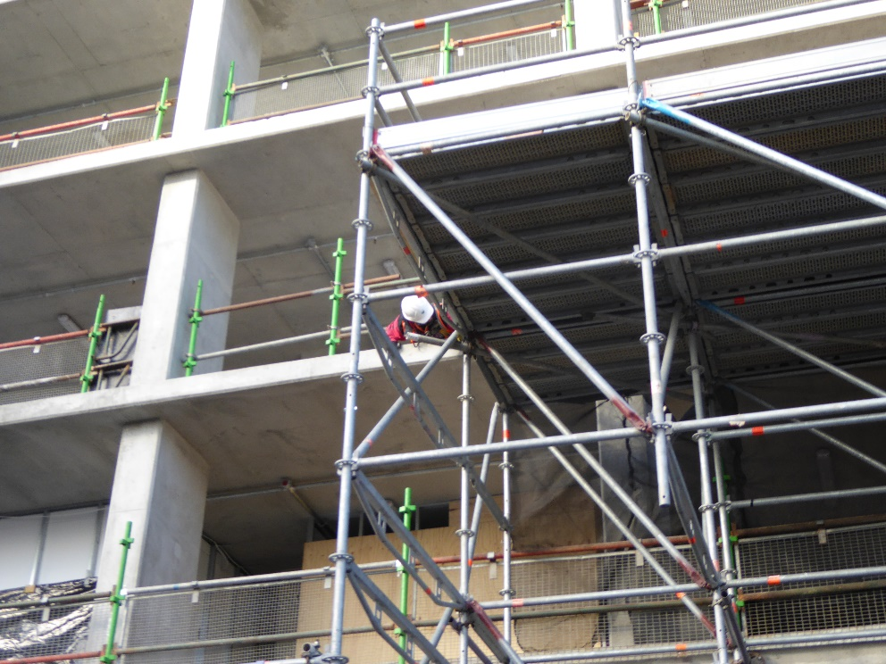
Current SA ANA List
ABC Dispute Resolution Services
Adjudicate Today
Australian Solutions Centre
Resolution Institute (formerly LEADR/ IAMA)
Master Builders Association (SA)
Nominator
RICS Dispute Resolution Service
[Note - Able Adjudication ceased in August 2016]

Slide 4
Building & Construction Industry Security of Payment Act 2009
Authorised Nominating Authority | Number of Adjudications received/awarded | Total Amount Claimed in 2017/18 | Total Amount Awarded in 2017/18
ABC Dispute Resolution Services | 6/5 | $467,792.45 | $221,054.73
Adjudicate Today | 50/15 | $10,740,287.98 | $1,508,798.65
Australian Solutions Centre | 0/0 | $0.00 | $0.00
Resolution Institute | 8/5 | $49,048,746.61 | $3,401,862.69
Master Builders Association of SA | 2/1 | $84,418.68 | $850.41
Nominator | 0/0 | $0.00 | $0.00
RICS Dispute Resolution Service | 1/1 | $13,843,651.93 | $1,449,628.88
TOTAL | 67/27 | $74,184,897.65 | $6,582,195.36

Slide 5
Building & Construction Industry Security of Payment Act 2009
Authorised Nominating Authority | Number of new Adjudications Received/Awarded 2018 September/December Quarters | Number of new Adjudications Year to Date 2018/19 | Total Amount Claimed Year to Date 2018/19 | Total Amount Awarded Year to Date 2018/19
ABC Dispute Resolution Services | 0/0 | 0 | 0 | 0
Adjudicate Today | 43/40 | 48 | $2,660,823.48 | $1,578,531.71
Australian Solutions Centre | 0/0 | 0 | 0 | 0
Resolution Institute | 5/4 | 6 | $25,435,235.32 | $3,492,953.34
Master Builders Association of SA | 0/0 | 0 | 0 | 0
Nominator | 0/0 | 0 | 0 | 0
RICS Dispute Resolution Service | 0/0 | 1 | $6,032,031.89 | 0
Total | 48/44 | 55 | $34,128,090.69 | $5,071,485.05

Slide 6
Building & Construction Industry Security of Payment Act 2009
Independent Review (Moss) commenced December 2014 and tabled in Parliament in May 2015
Following the collapse of Tagara Builders in June 2016, further consultation with industry, industry associations and key stakeholders on 16 specific proposals
Amending Bill introduced in October 2017. Passed House of Assembly but was not considered by Legislative Council before Parliament was prorogued for the 2018 election

Slide 7
Building & Construction Industry Security of Payment Act 2009
Amending Bill introduced in October 2017. Passed House of Assembly but was not considered by Legislative Council before Parliament was prorogued for the 2018 election
The national “Review of Security of Payment Laws” (the Murray Review) prepared by Mr John Murray AM was released publicly on 21 May 2018

Slide 8
National Review
Extensive consultation with stakeholders in second half of 2018
Comprehensive testing of proposed recommendations against existing South Australian legislation
Informed by assessment of recommendations and feedback from consultation on the Review
SA Small Business Commissioner supportive of most, but not all, recommendations from Murray Review
Mixed response from industry
Most concern surrounds trusts

Slide 9
National Review
Small Business Commissioner has been working with Minister for Industry and Skills, Hon David Pisoni MP as well as Minister for Transport, Infrastructure and Local Government Hon Stephan Knoll MP
Minister Knoll is the SA representative on the COAG Building Ministers’ Forum (BMF)
Most recent BMF meeting in February 2019
SA Government now finalising position on Murray Review with solid input from Small Business Commissioner
Notes:
Replace the ANA authorisation regime
The Bill will also replace the ANA Authorisation regime that currently applies to the 7 Nominating Authorities that are currently authorised within South Australia.
A new and reorganised regime will place some light-handed rigour and oversight to the ‘open-ended’ authorisation arrangements that were implemented when the legislation became operational in December 2011. The Bill also provides the Commissioner with greater oversight of the arrangements for both ANAs and the adjudicators that operate under them.

Slide 10
Building and Construction Industry Dispute Resolution Code
The new Fair Trading (Building and Construction Industry Dispute Resolution Code) Regulations 2017 – was developed under the Fair Trading Act 1987 and came into effect on 5 December 2017
The Code mirrors the 5 other Industry Codes (Farming, Newsagency, Motor Vehicles, Franchising, Mining and Farmers) that provide the Commissioner with extra powers to compel disputing parties to participate in an alternative dispute resolution - including ‘good faith’ mediation

Slide 11
Building and Construction Industry Dispute Resolution Code
Participants in the building and construction industry can apply to the Small Business Commissioner for dispute resolution under the Code
However, the Code can only be activated by the Small Business Commissioner
Applicant needs to satisfy the Small Business Commissioner
  they have attempted to resolve the dispute; and
  the dispute is not frivolous or vexatious

Slide 12
Building and Construction Industry Dispute Resolution Code
Under the Code, the Commissioner has the power to require parties to:
  attend meetings;
  exchange information;
  answer questions; and
  participate in alternative dispute resolution process
  engage a technical expert to assist

Slide 13
Building and Construction Industry Dispute Resolution Code
2 levels of penalties for breaches of the Industry Codes under the Fair Trading Act 1987 - a civil expiation notice for breaches of a particular Code, or prosecution for a civil penalty of up to $50 000 for a corporation
(or $10 000 for a natural person)
The Code provides for mandatory Alternative Dispute Resolution processes at no, or low cost to participants

Slide 14
Support of the Act
Education Program Manager:
engages closely with relevant industry associations
supports the delivery of information, education and resources to industry
conducts regular information sessions for sub-contractors
prepares marketing materials including on-line and social media
provides advice and support to the Small Business Commissioner on disputes within the building and construction industry and complaints received under the new Building and Construction Industry Dispute Resolution Code

Slide 15
Support of the Act
Industry associations currently undertaking promotion and education in Security of Payment and the adjudication process
  Australian Subcontractors Association Sa
  Civil Contractors Federation SA
  Housing Industry Association SA
  Master Builders Association of SA
  National Electrical & Communications Association SA/NT
Positive feedback has been received from participants attending education sessions

Slide 16
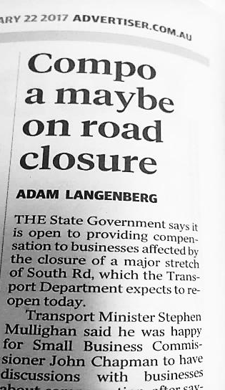
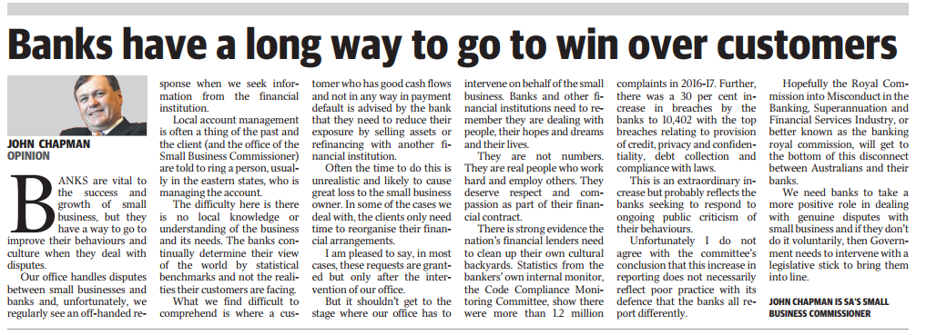
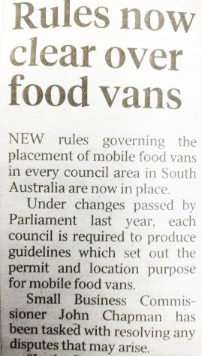
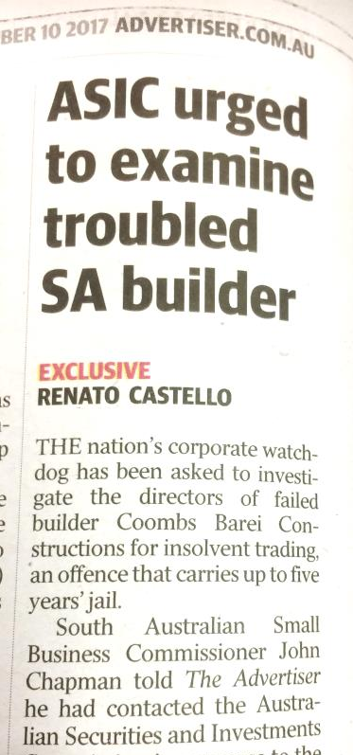
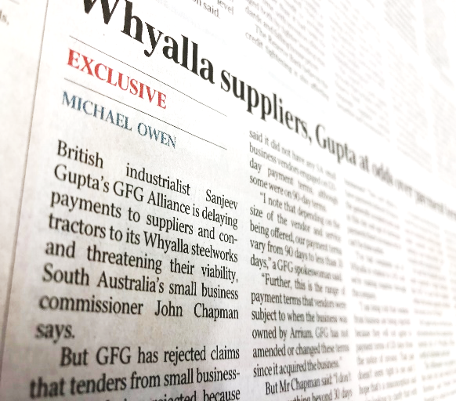
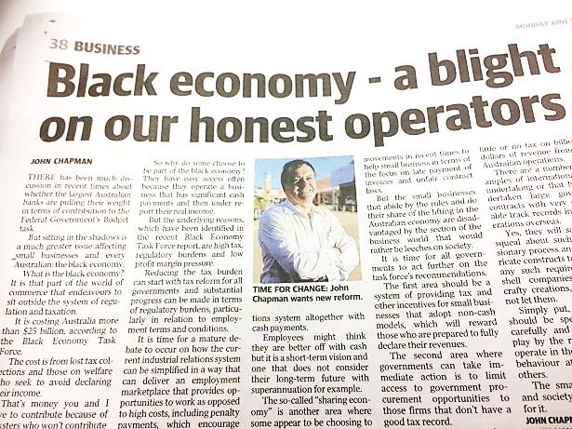
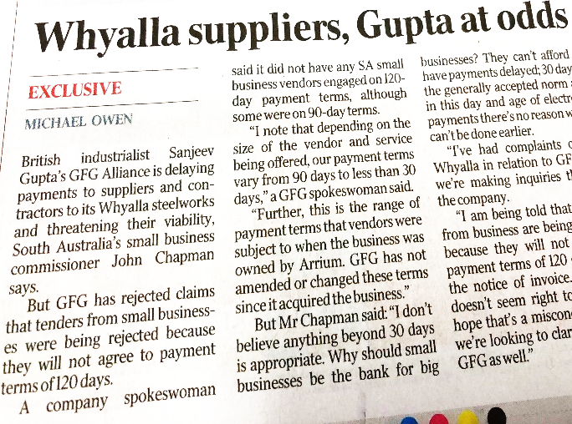
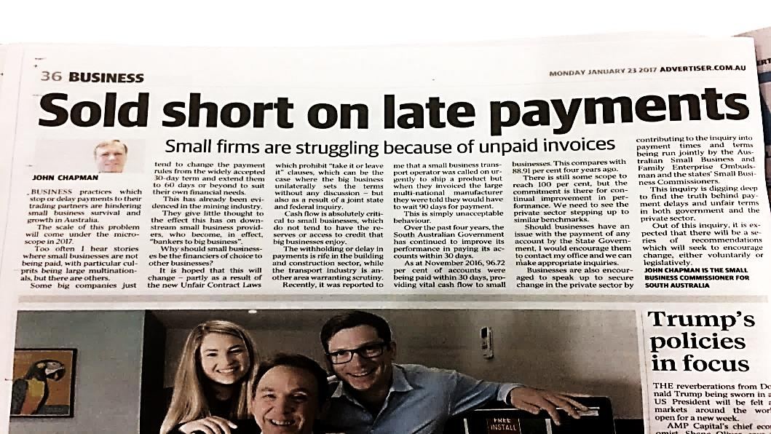
Advocate

Slide 17


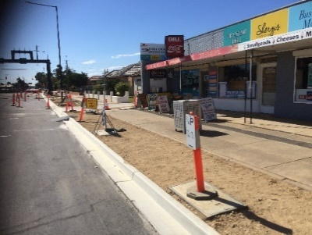
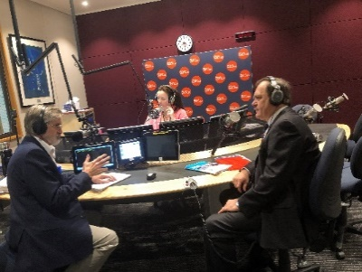

Slide 18

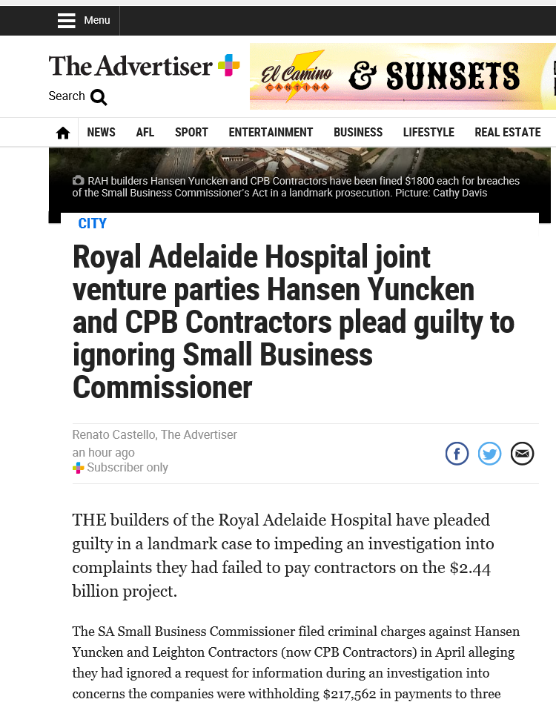
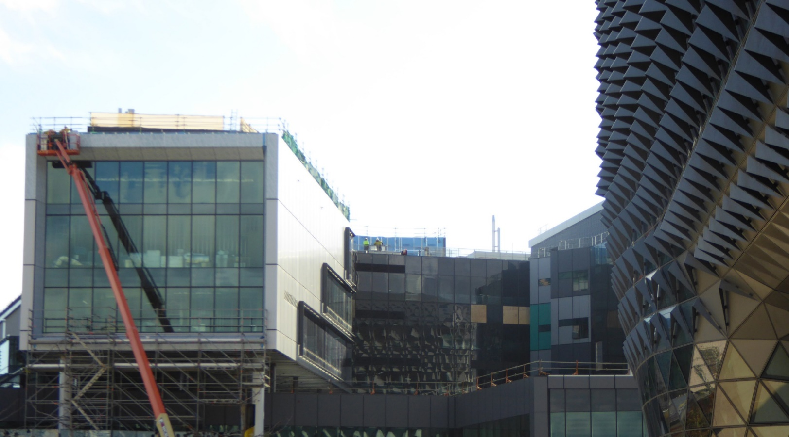

Slide 19

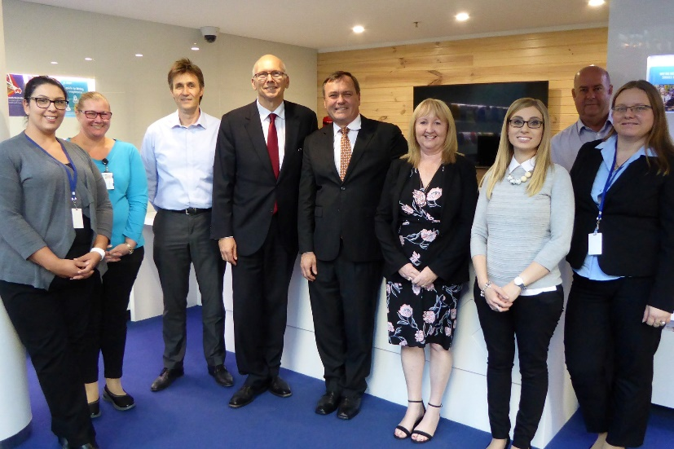
Thank you
1800 072 722 or 08 8303 2026
sasbc@sa.gov.au
www.sasbc.sa.gov.au
Ground Floor, 99 Gawler Place, Adelaide
GPO Box 1264, Adelaide SA 5001
sasmallbusinesscommissioner
SA Small Business Commissioner

