Slide 1

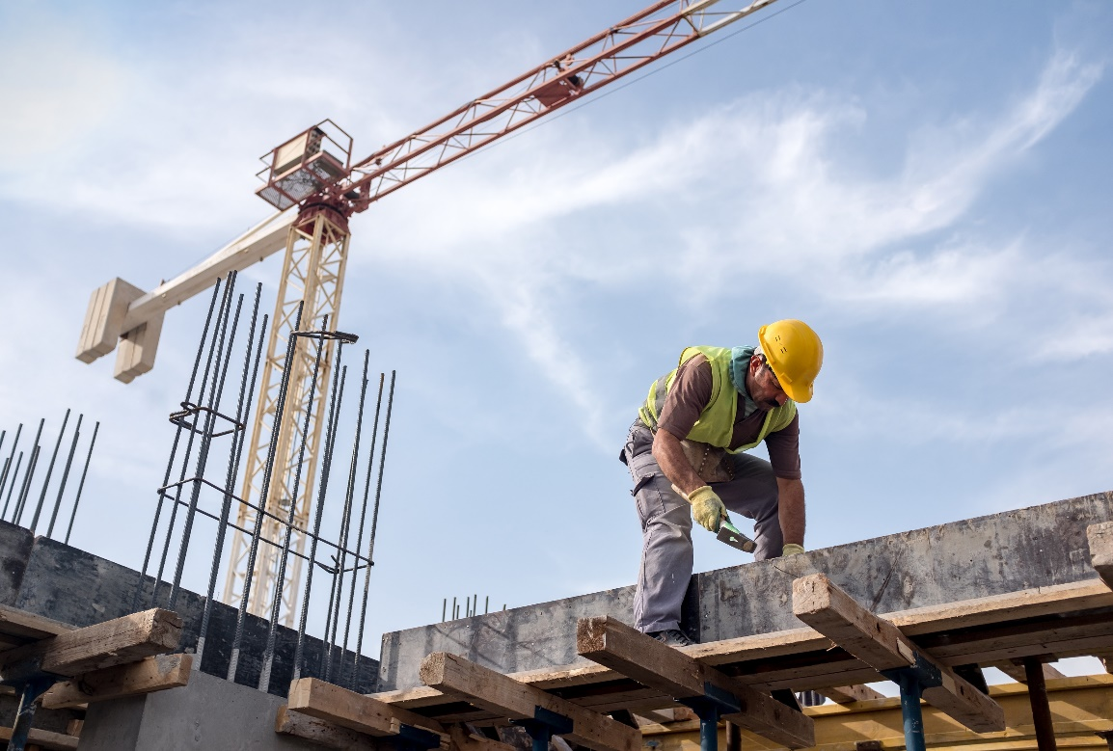
Adjudicate Today Seminar – WA Update 2019
Presented by:
Dan Kearney, A/General Manager, Policy and Legislation Branch

Slide 2

Who?
Building and Energy is an amalgamation of the former WA Building Commission and the Office of Energy Safety.
Building and Energy is responsible for the regulation of builders, plumbers, building surveyors, painters, gasfitters and electricians in WA.
Additionally, the Building Commissioner is also responsible for performing functions under the Construction Contracts Act 2004 (CCA) and general administration.
The majority of the BC’s functions are delegated.
Small team that carries out the administrative functions and provides policy advice on matters related to the CCA.

Slide 3
What has been happening in WA?
Sustained decrease in building and construction activity in WA over the last five or more years:
  Sharpening in competition – pushing of risk down the contracting chain to small business;
  Unsustainable bidding practices;
  Culture of delayed or non-payment
  Increase in business failures, particularly at the top of the supply chain.
A number of high profile company collapses.
These issues have a had a big impact on small business subcontractors.
Government election commitment – to look at reforms to improve payment practices.

Slide 4
National review into security of payment laws across all jurisdiction which has identified a need for greater consistency and other measures.
In response to these issues, Govt. commissioned inquiry process chaired by John Fiocco and Matthew Swinbourn to consult with stakeholders on measures that could improve payment protections in the industry. Particular focus on protections for small business subcontractors, reforms in other states and territories and the national review.
Report with 44 recommendations provided to the Minister/Government at the end of last year.

Slide 5


How?
East is East, West is West – perhaps not anymore.
Significant reform to WA security of payment laws to align more closely with other jurisdictions (East Coast model) and some of the legislative best practices from Murray Report
Increased powers for the Building Commissioner to:
Take action against building service provides who fail to pay debts
Remove those from the industry with a history of insolvency
Better insolvency protection through:
Express retention trust scheme; and
Statutory construction trust scheme for works over $1 million, but phased in over time to allow industry to adjust
New laws to promote fairer contracting practices, in particular placing limits around the withholding of performance security
Focus on education to support reforms and improve business practices

Slide 6

When?
Govt. currently reviewing the recommendations, implications and considering industry feedback.
New Minister has already announced to WA industry his intention to adopt majority of recommendations, including construction trusts and East Coast model.
Likely to be some ‘minor tweak’.
Formal announcement to be made in due course.
Recommendations will have far reaching consequences for how the industry operates and cash flow.
In an industry that is notoriously under-capitalized the trust scheme will significantly alter the way cash is used. This will apply up and down the contracting chain.
Significant law reform and industry up-skilling

Slide 7
BUT………….. in the interim?
National harmomisation?
WA continuing to work through the BMF, but Govt. keen to move forward with reform as soon as practicable.
Industry can’t sit and wait for national harmomisaton.
WA likely to aim for greater national consistency, rather than full harmomisation. Major step is to adopt the vast majority of Murray and Fiocco report recommendations.
Increased use of Project Bank Accounts on State Government-funded projects over $1.5million
More subcontractor support through SBDC

Slide 8
Contact
Dan Kearney, Acting General Manager, Policy and Legislation Branch A
Building & Energy
Phone: 08 6251 1043
Email: daniel.kearney@dmirs.wa.gov.au or cca@dmirs.wa.gov.au
Want to know more?
www.dmirs.wa.gov.au/building-commission/construction-contracts-act

